Slide 1
Just Beyond Simple SQL – How to Dramatically Improve Your Argos Queries Session ID: 539
2011 Evisions Conference
Bruce Knox
Project/Program Director (A.K.A . Sr. Programmer/Analyst)
University of Arkansas
Division of Agriculture Cooperative Extension Service
bknox@uaex.edu
March 19, 2011

Slide 2
Session Rules of Etiquette
Please turn off your cell phone.
If you must leave the session early, please do so discreetly and quietly.
Please avoid side conversation during the session.
Thank you for your Cooperation!

Slide 3
Agenda
Oracle Tuning – Keeping It Simple

Slide 4
Agenda
Oracle Tuning – Keeping It Simple
The “Driving” Query Concept

Slide 5
Agenda
Oracle Tuning – Keeping It Simple
The “Driving” Query Concept
Introducing the Global Temporary Table

Slide 6
Agenda
Oracle Tuning – keeping it simple
The “Driving” Query Concept
Introducing the Global Temporary Table
Yes, PL/SQL really can be used in Argos!

Slide 7
Agenda
Oracle Tuning – Keeping It Simple
The “Driving” Query Concept
Introducing the Global Temporary Table
Yes, PL/SQL really can be used in Argos!
Some Simple PL/SQL Examples

Slide 8
Oracle Tuning
You can spend weeks tuning a complex Query
Using only Indexed Columns for joins
Avoiding the != and IN, and especially the NOT IN
Your DBA can run EXPLAIN PLANs and
do SQL_TRACEs for you
It takes a lot of effort then,
Oracle Changes the way it all works.
Notes:
There are many technical books on this topic, and most of us will never understand them.

Slide 9
The “Driving” Query
At one time placing the smallest Table first helped
Or, was it last?
No longer matters, but the idea was to use this smallest Table as the Driver for the Joins.
Oracle now decides which it should use

Slide 10
The “Driving” Table, Sort of
Any time you present your Query a small TABLE rather than a large one, it helps
If you can avoid re-Querying a TABLE, do so.
Reduce the number of TABLEs
Reduce the number of RECORDs
Notes:
Simple optimization rules.

Slide 11
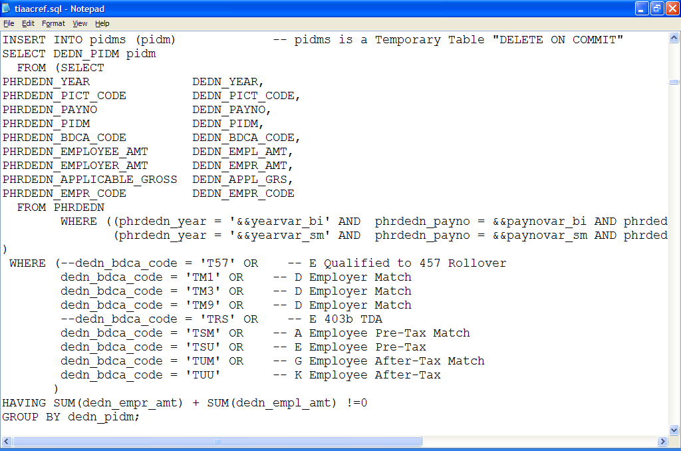
TIAA-CREF Design has many records per employee
Notes:
TIAA-CREF design required outputting many record formats each needing this Query code.
Our small Banner has only BKNOX: ACES> select count(*) from PHRDEDN;
COUNT(*)
----------
2928375
vs.
518 rows selected for what I needed.

Slide 12
2,928,375 vs. 518 rows
Notes:
When I only wanted 518 records.

Slide 13
So, I extracted the 518 records once
Query them Once.
Use the Query Subset many times.

Slide 14
So, pidms rescues my code
Notes:
Plus 10 more Queries UNION ALL’d together for the same pidms.

Slide 15
PL/SQL
Yes, PL/SQL really can be used in Argos!

Slide 16
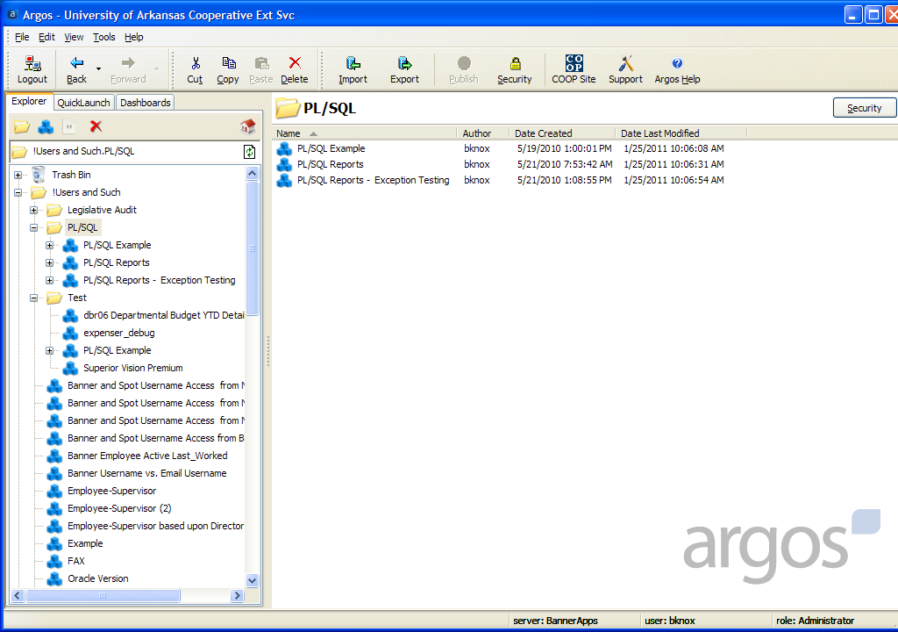

Slide 17
A Simple PL/SQL Example

Slide 18
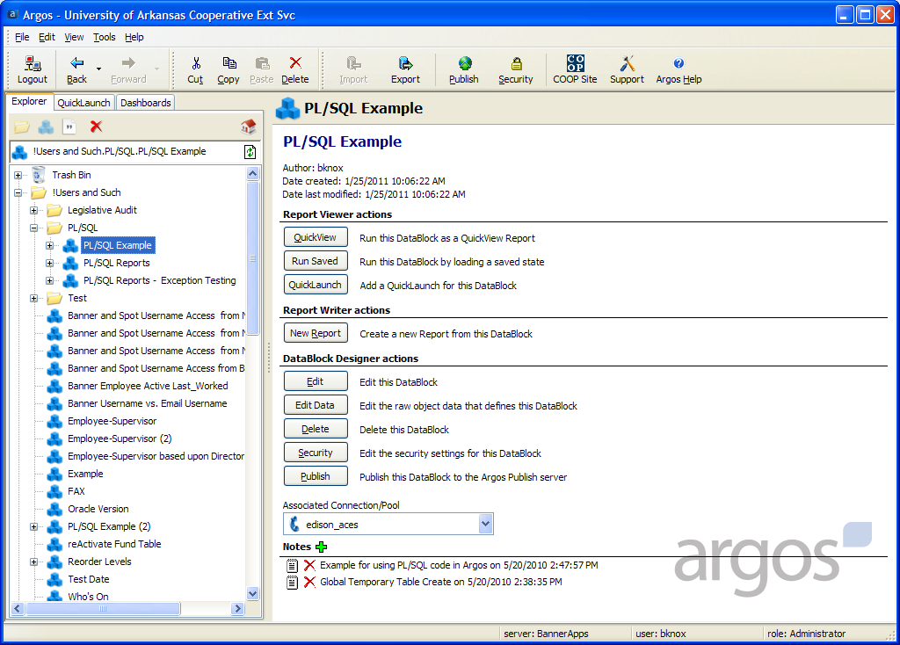

Slide 19
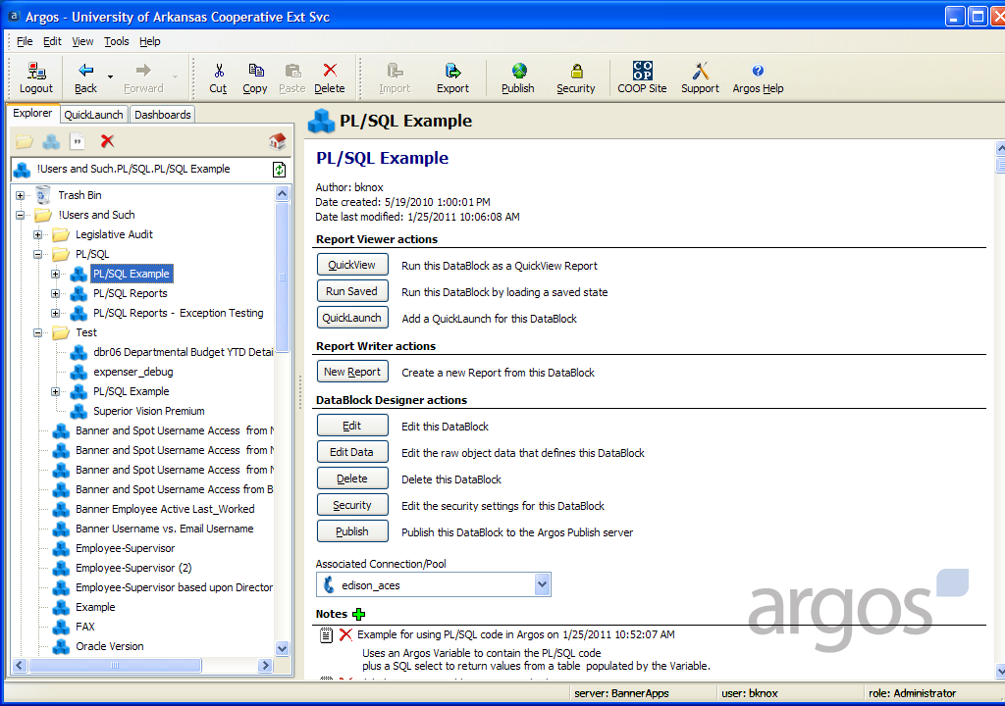

Slide 20
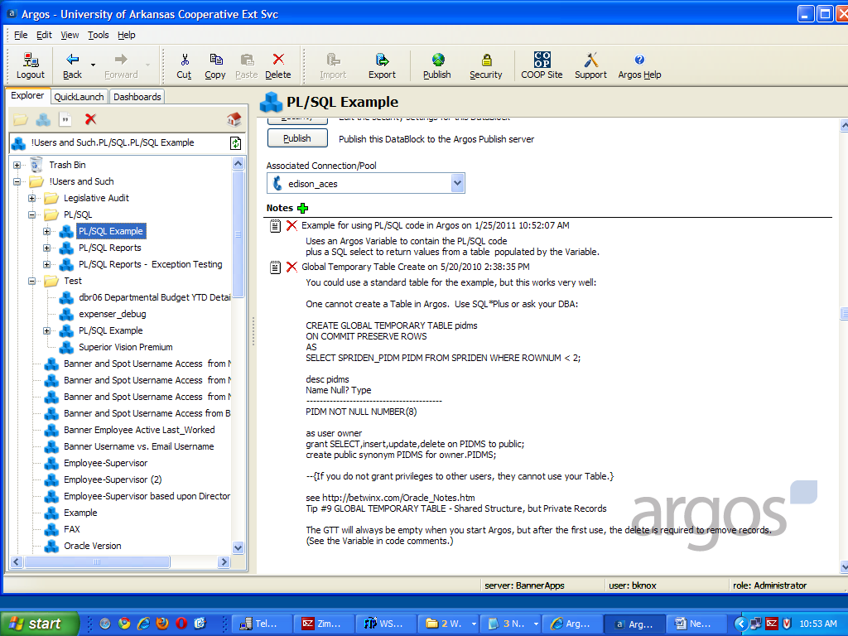
Notes:
Why a GTT instead of a standard TABLE? It can be used by many users without special code to separate their data.

Slide 21
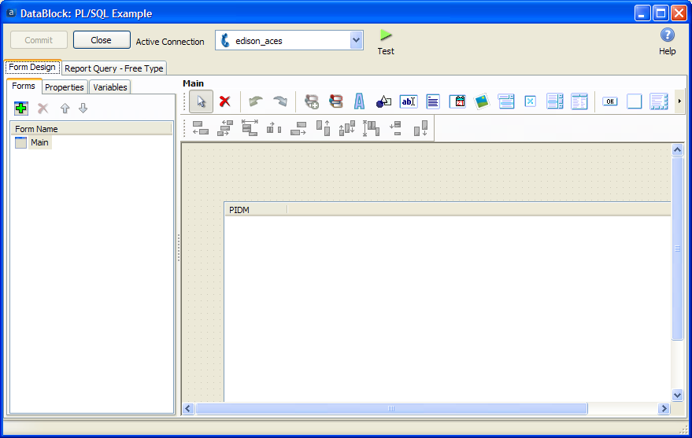
Notes:
Form Design

Slide 22
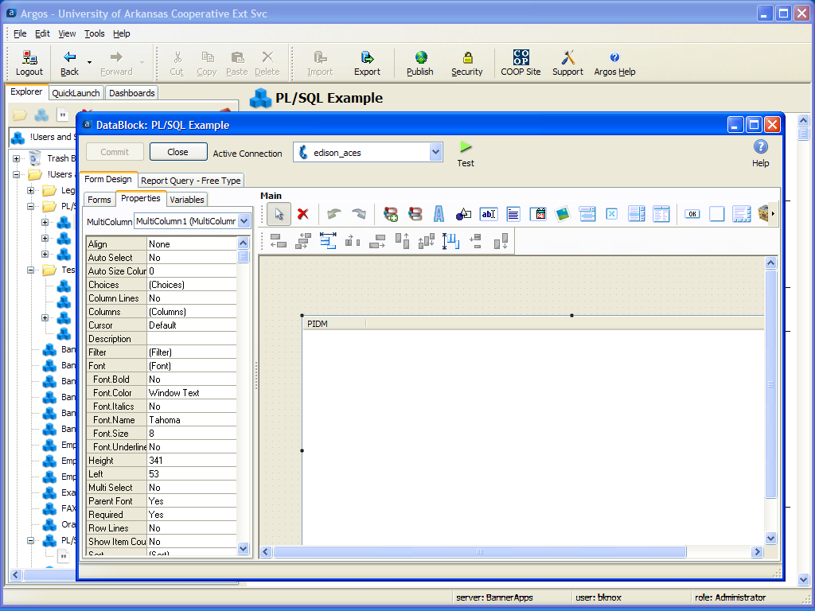
Notes:
Form Properties

Slide 23
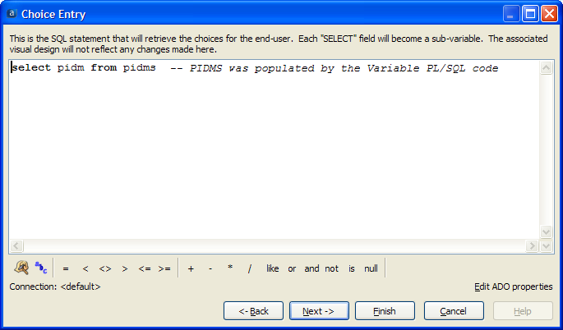
The Form Code
Notes:
Form Code

Slide 24
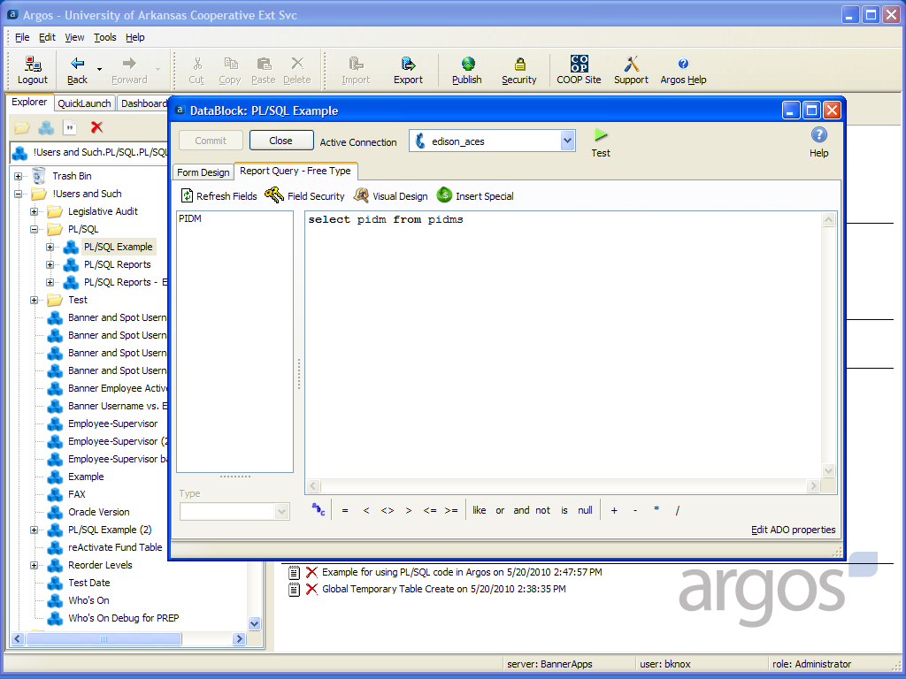
Notes:
Report Code

Slide 25
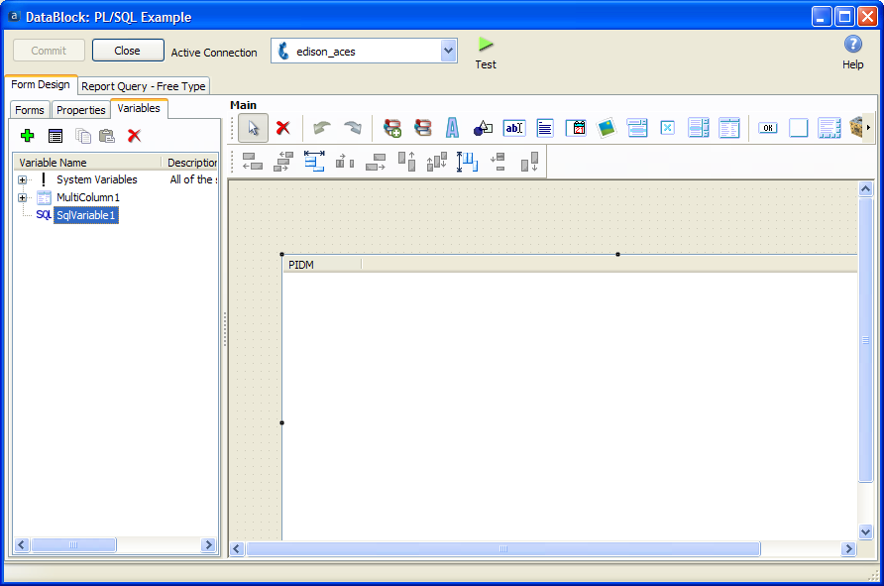
Notes:
The Variable

Slide 26
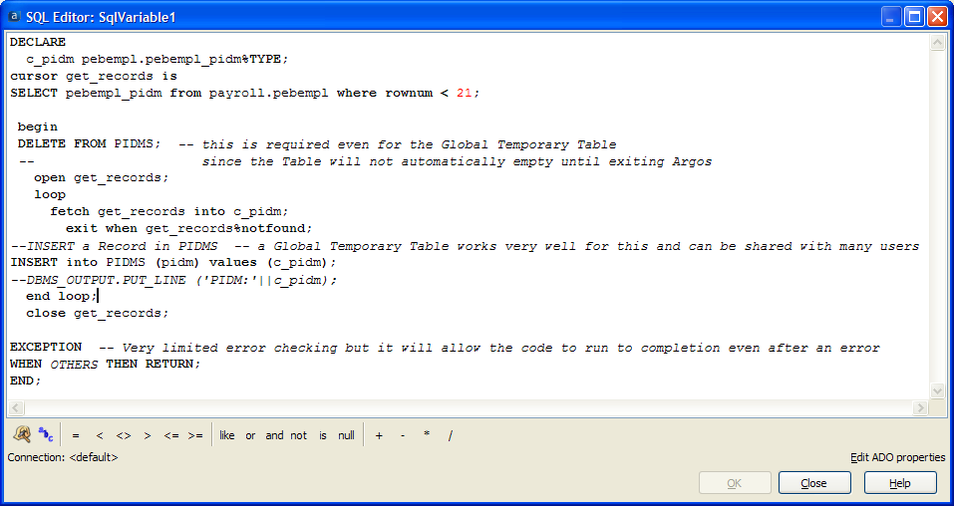
Variable Code
Notes:
Last time I checked, the GTT was empty when re-entered in Argos. Deleting all the records in an Empty Table is very fast.
The GTT is just one way. A standard TABLE would easily work very well for this too, if not shared.

Slide 27
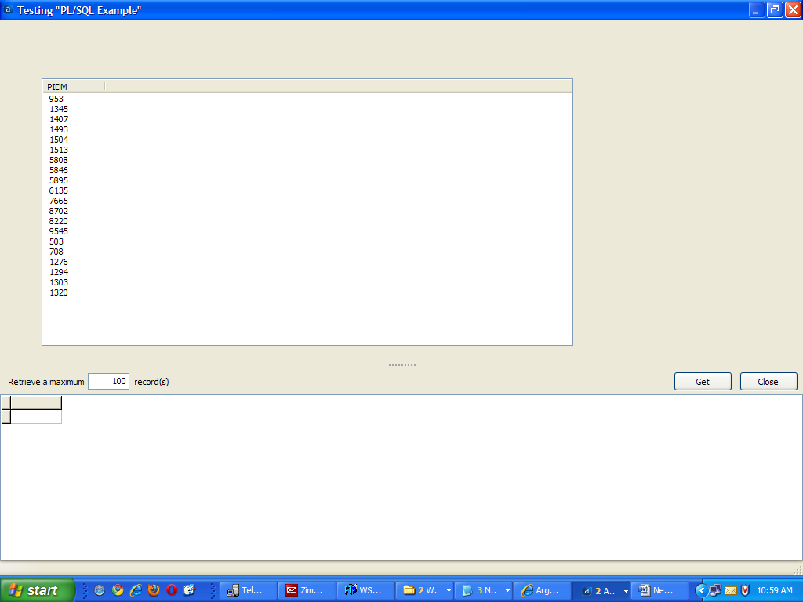
Notes:
Testing the Form.

Slide 28
Notes:
Then the Get for the Report.

Slide 29
PL/SQL Reports - A Conversion Solution
Notes:
Intended to be used to convert reports that were written to use Oracle PL/SQL Server Output such as DBMS_OUTPUT.PUT_LINE. It is not intended for use with SQL or SQL*Plus only conversions.

Slide 30
PL/SQL Reports - A Conversion Solution
Intended to be used to convert reports that were written to use Oracle PL/SQL Server Output such as DBMS_OUTPUT.PUT_LINE.
It is not intended for use with SQL or SQL*Plus only conversions.
Notes:
Intended to be used to convert reports that were written to use Oracle PL/SQL Server Output such as DBMS_OUTPUT.PUT_LINE. It is not intended for use with SQL or SQL*Plus only conversions.

Slide 31
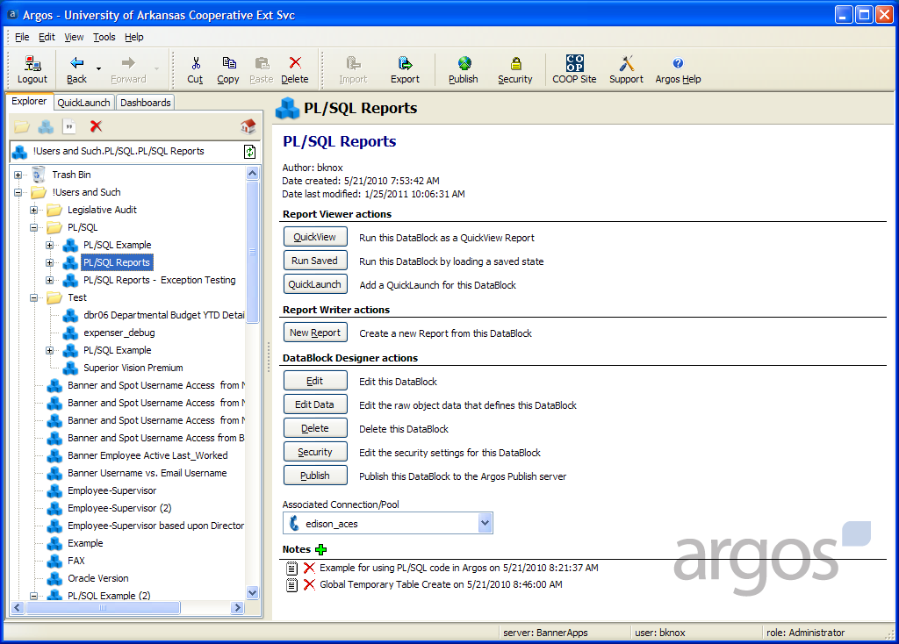

Slide 32
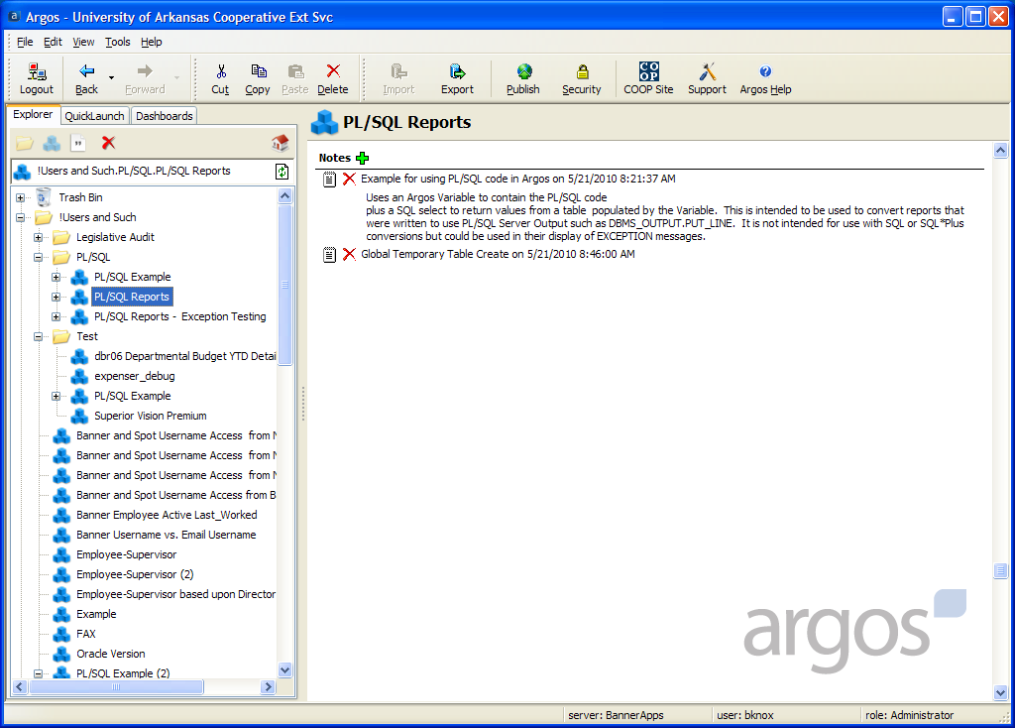

Slide 33
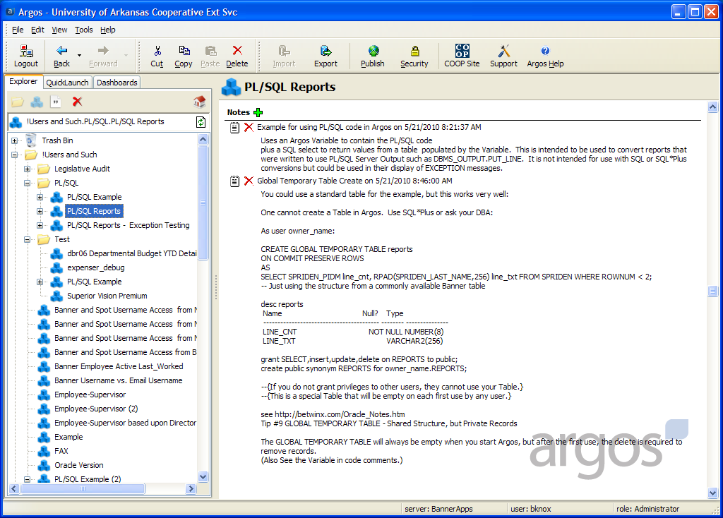
Notes:
Note the Line Count LINE_CNT is needed to keep the detail lines in order.

Slide 34
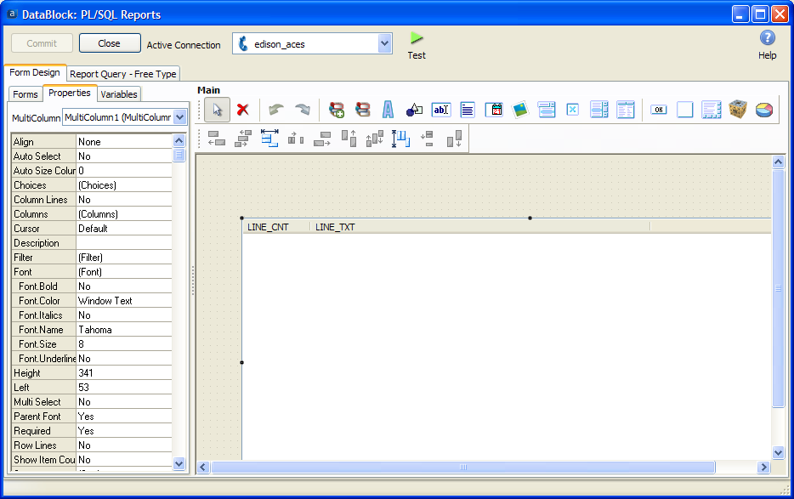
Notes:
Form Design

Slide 35
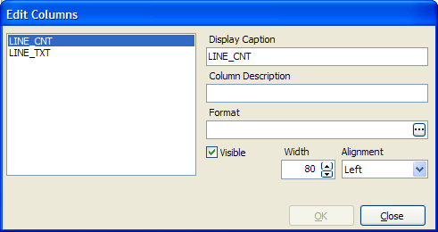
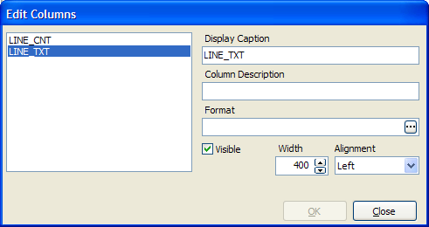
Columns
Notes:
Columns

Slide 36
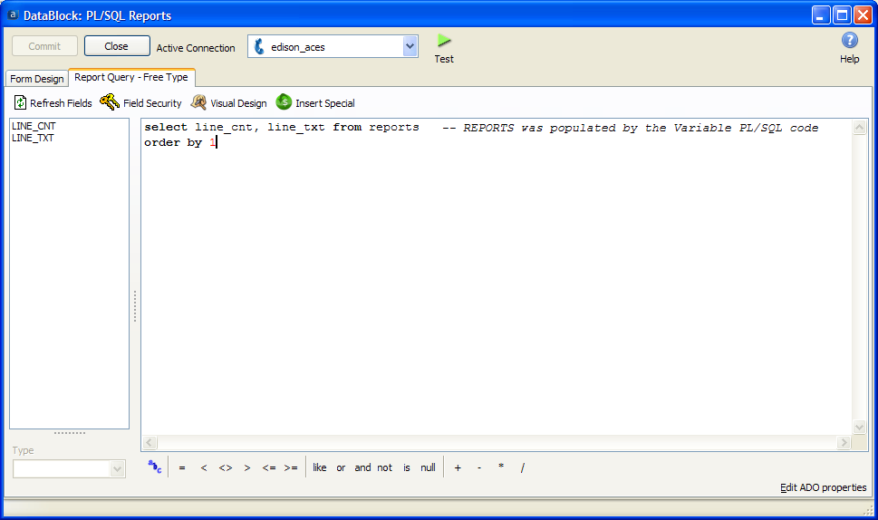
Report Query
Notes:
ORDER BY 1 is required to keep the detail lines in their original order. It is just the way Oracle works.

Slide 37
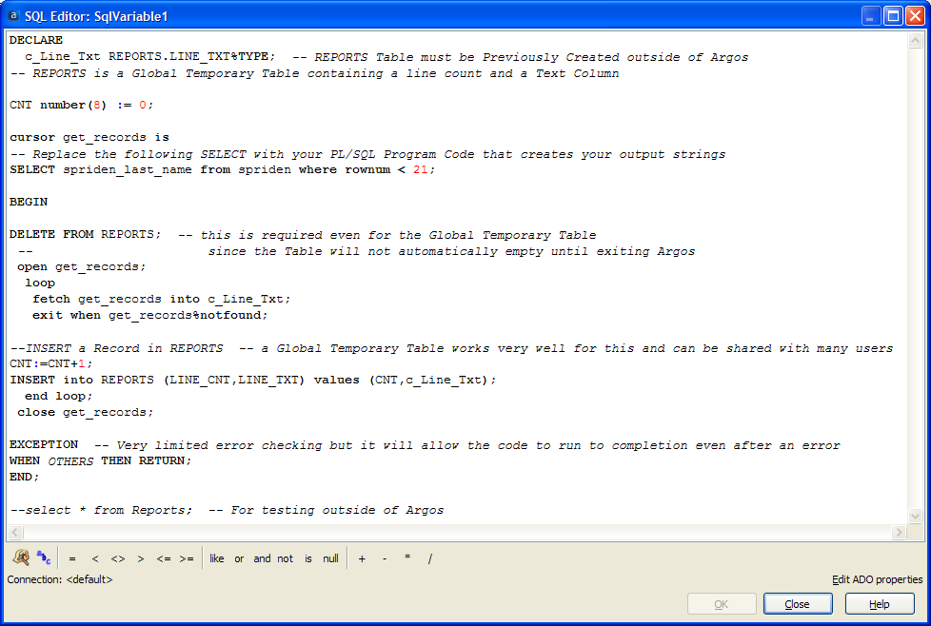
Notes:
This was written to give an example of how to convert PL/SQL “Reports” to Argos.

Slide 38
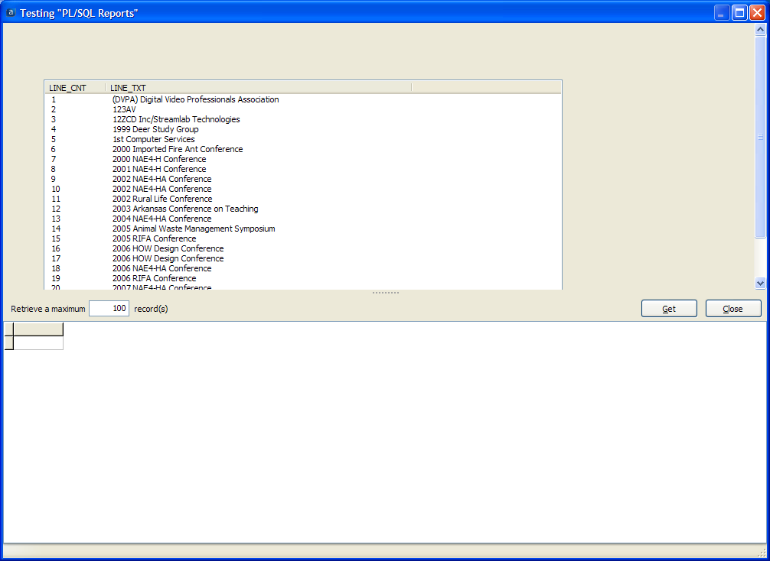
Notes:
Test the Form.

Slide 39
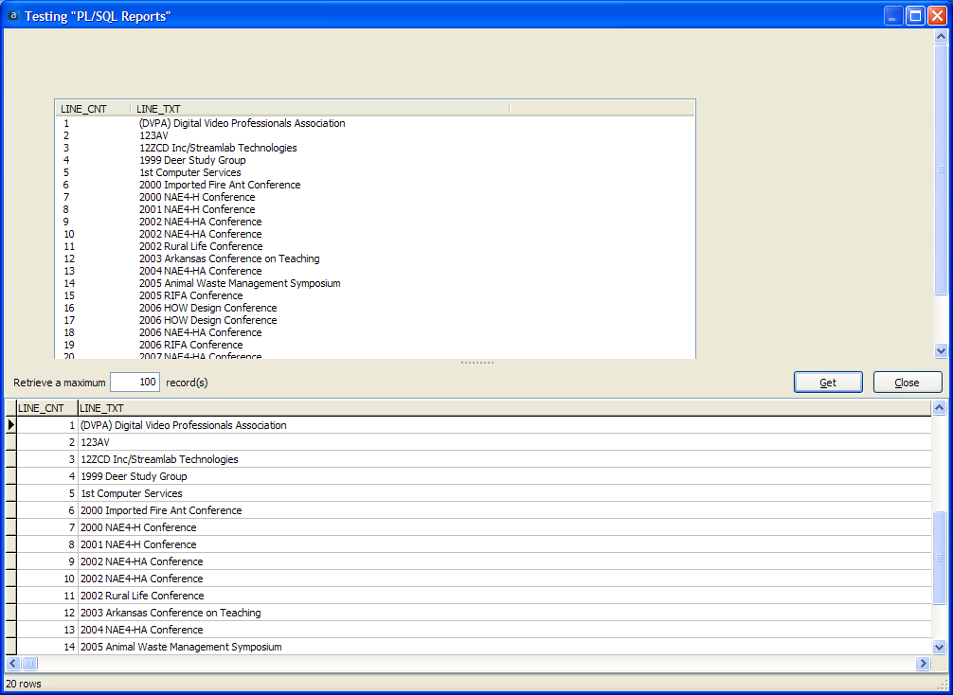
Notes:
Test the Report Get.

Slide 40
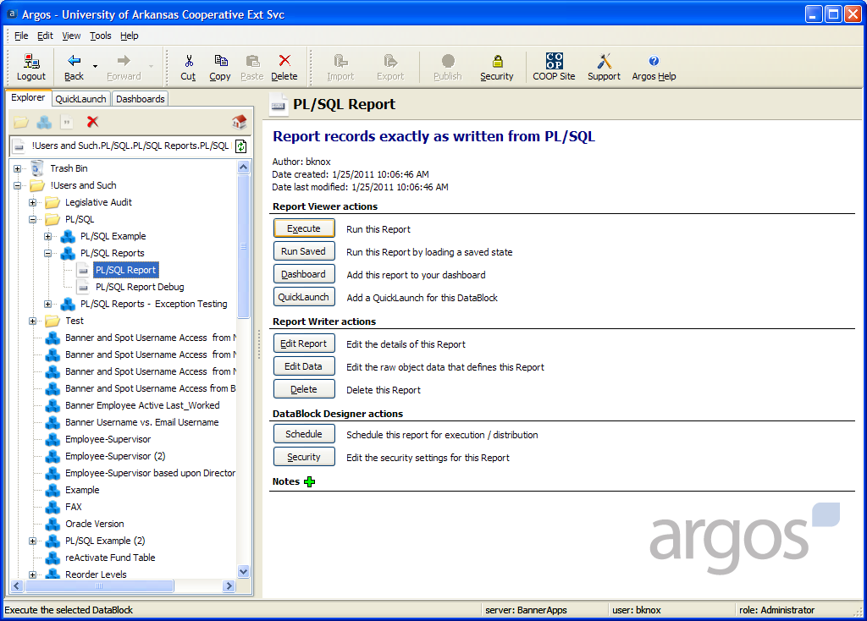
Notes:
Or, Execute a Report.

Slide 41
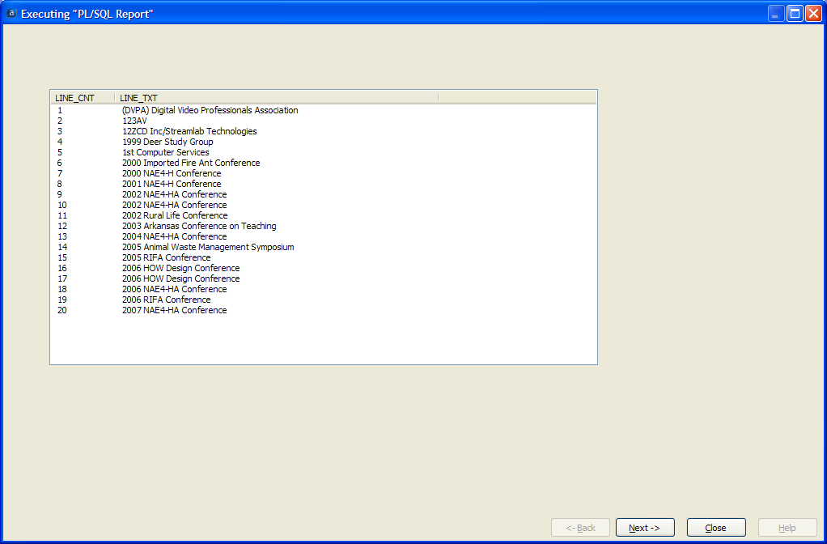
Notes:
The Form.

Slide 42
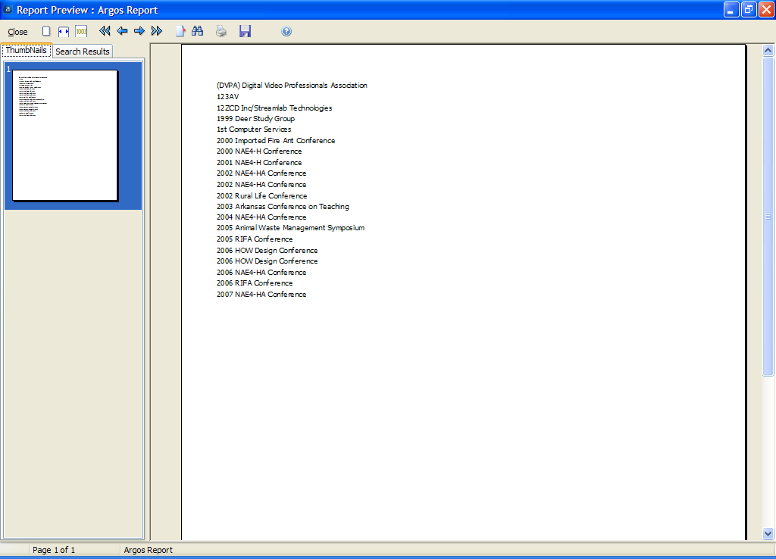
Notes:
Preview Report

Slide 43
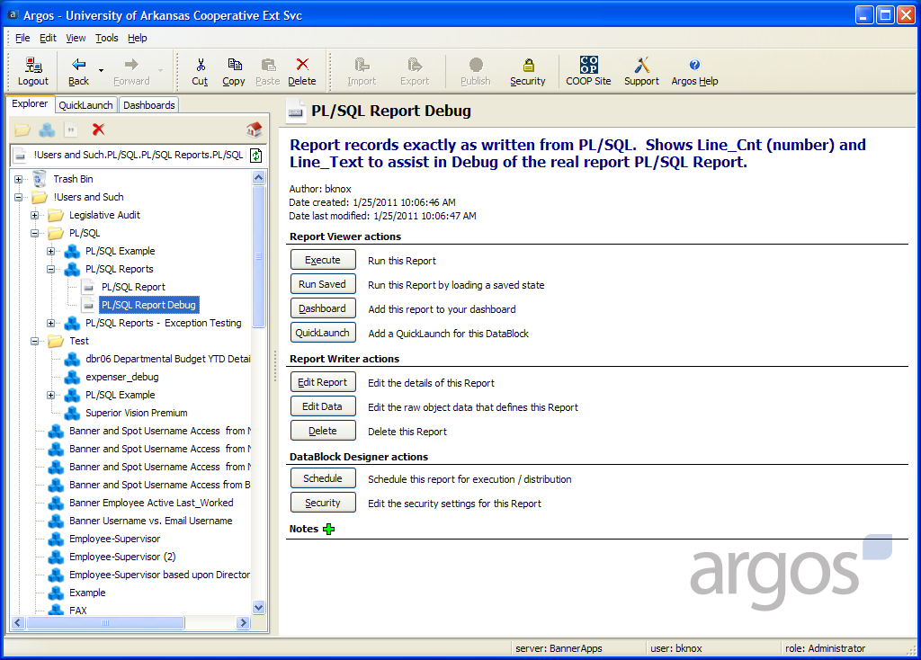
Notes:
Just for Debug.

Slide 44
Notes:
Execute

Slide 45
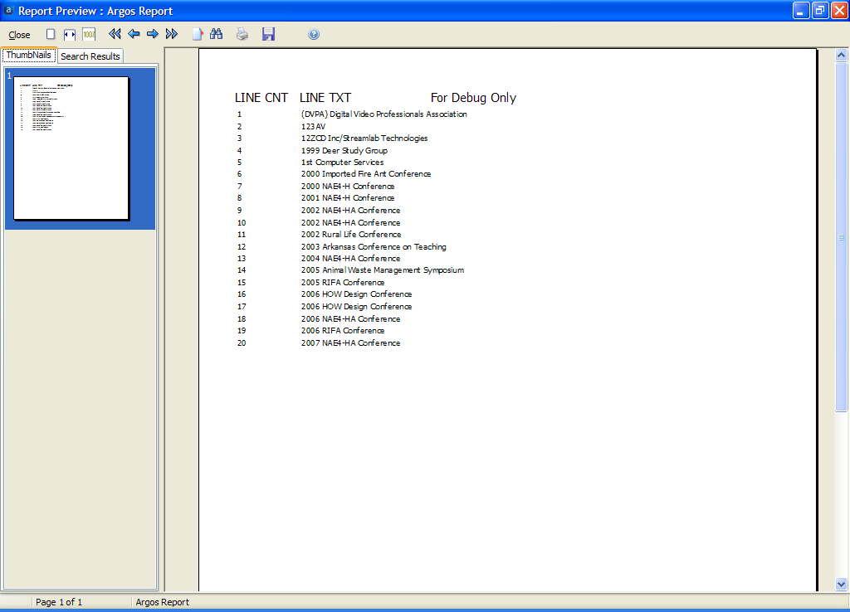

Slide 46
PL/SQL EXCEPTION
Error handling or reporting
Notes:
Just adding error reporting to the previous DataBlock.

Slide 47
Notes:
The Same PL/SQL but with a forced EXCEPTION.

Slide 48
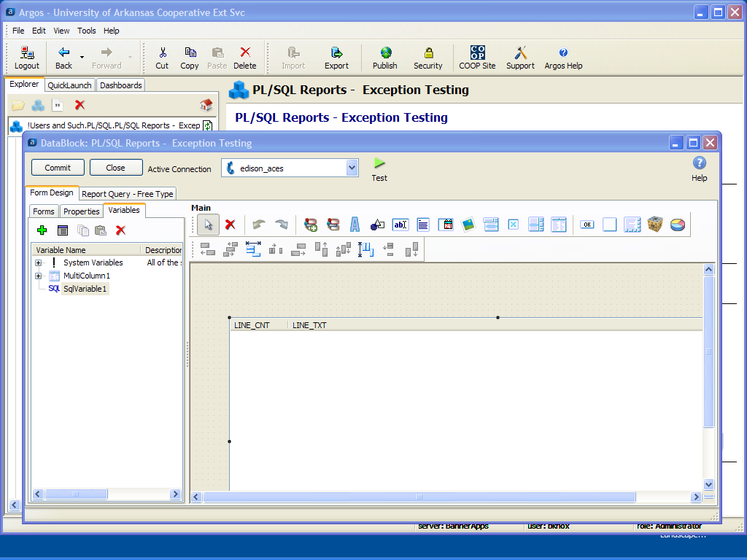
Notes:
Form Design

Slide 49
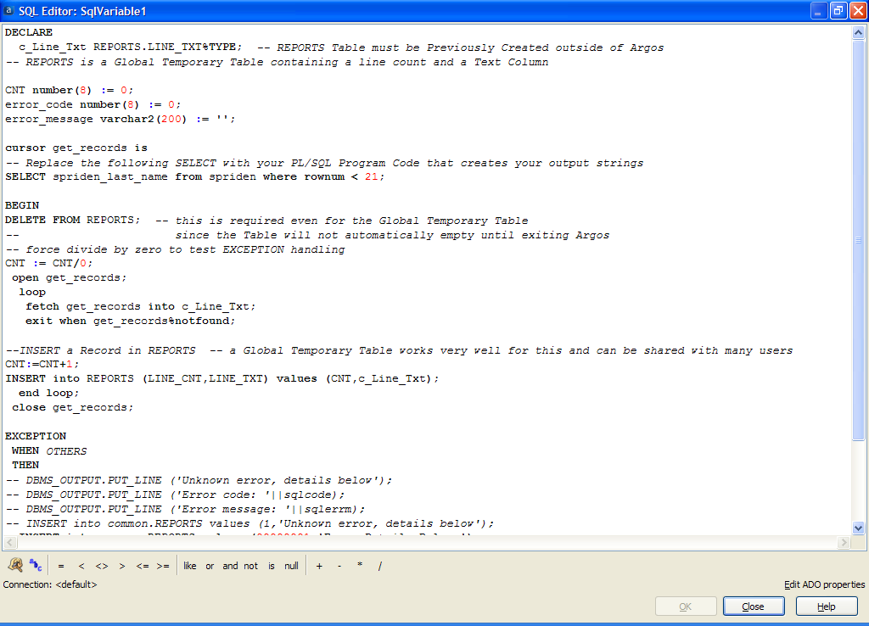
Notes:
Note the Divide by Zero.

Slide 50
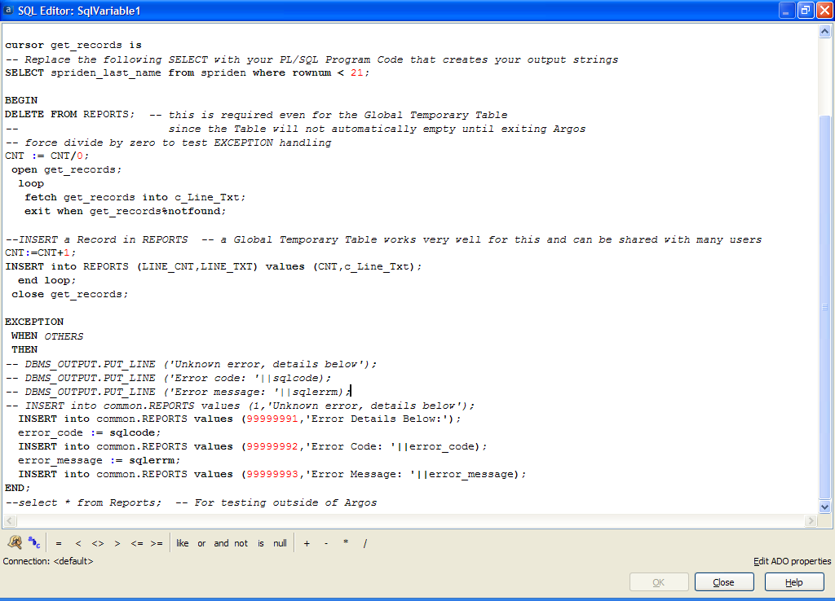
Notes:
Note the EXCEPTION detail.

Slide 51
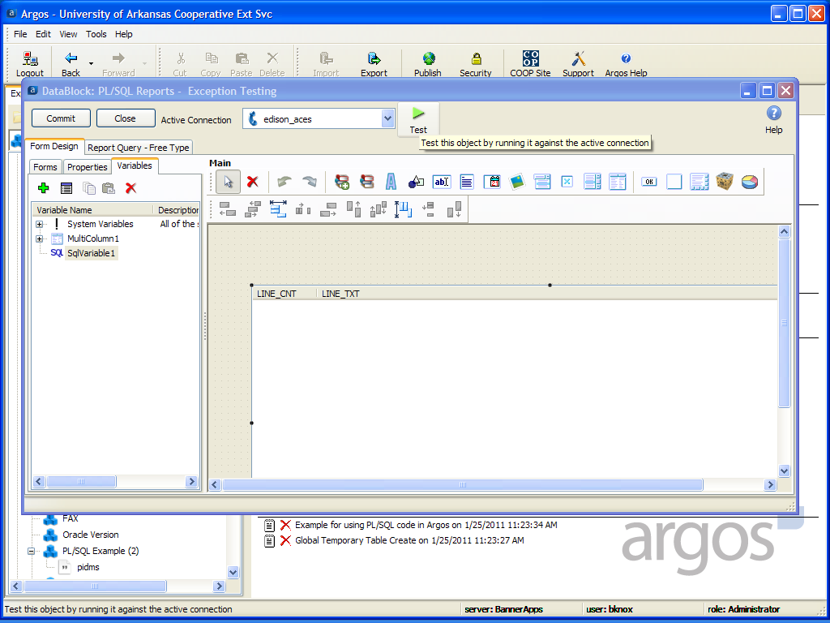
Notes:
Form Design Test

Slide 52
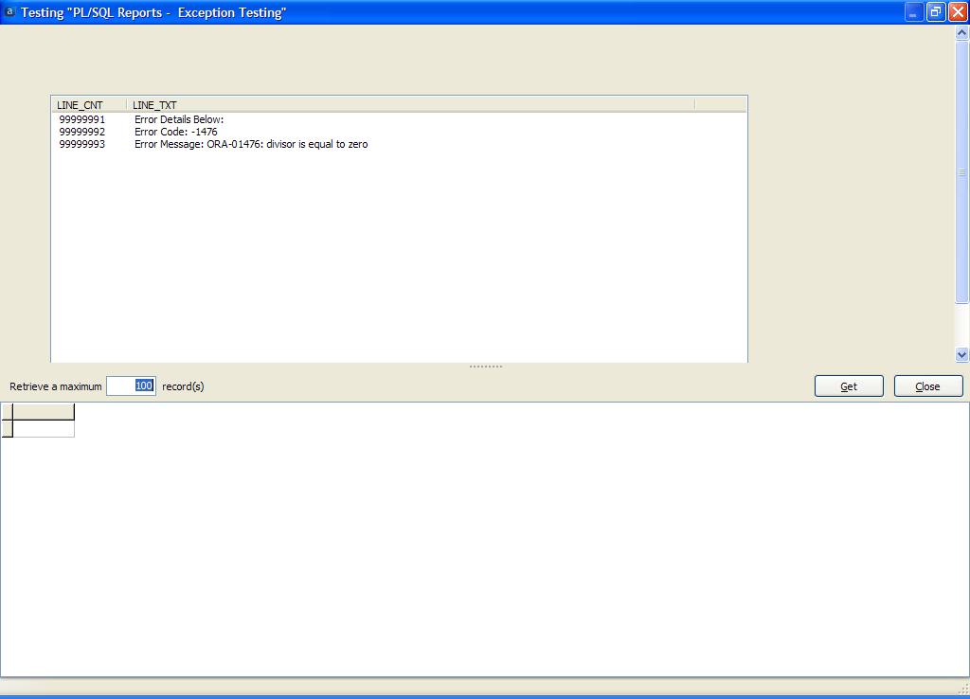
Notes:
Displaying the EXCEPTION using the same code that would report good Records from the Query.

Slide 53
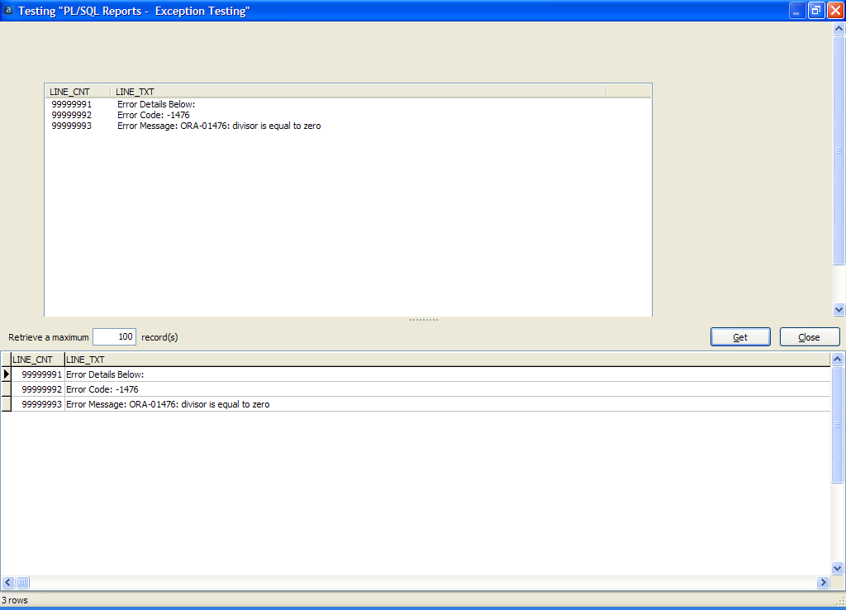
Notes:
So, the EXCEPTION would be displayed in either Form or Report.

Slide 54
COOP’d This Project
Jim Ollerhead University of Salford
Zach Heath Evisions
Cavin Deiterich Harrisburg Area Community College
John Reebel John Carroll University
Notes:
This was cooperatively developed by many of us over a long period. The listed individuals were involved in the final work, but there may well be several others that contributed to this solution.

Slide 55
Question?

Slide 56
Questions?
Bruce Knox: bknox@uaex.edu
http://betwinx.com/

Slide 57
COOP
The Argos COOP has the objects used in these examples: Search for bknox or PL/SQL
http://www.evisions.com/Support/COOPUserCommunity/Share.aspx
Notes:
Argos DataBlocks

Slide 58
Questions?
Bruce Knox: bknox@uaex.edu
http://betwinx.com/
You will find many hints for using Argos here:
http://betwinx.com/BannerArgos.htm
http://www.argosreporting.net/
http://bannerreporting.blogspot.com/
Notes:
Other Resouces!

Slide 59
Questions ?
Please complete a session evaluation form This session ID is 539
For further information please contact Bruce Knox: bknox@uaex.edu
or
Evisions’ Professional Services at proservices@evisions.com
Notes:
Many Thanks!

